Slide 2
CLICK HERE TO ADD TITLE
Click here to add subtitle

Slide 3
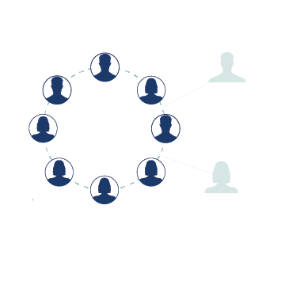
ABOUT NASPE
The National Association of State Personnel Executives (NASPE) provides a collaborative forum for State HR leaders to share effective leading practices.
We are the authority on leading state HR practices and strategies focused on developing an effective State workforce
State membership
Corporate membership
Notes:
Provide a brief history about NASPE – the mission and organization
Explain Membership and who we represent
Briefly introduce the vendor concept – we will touch on in a later slide.

Slide 4
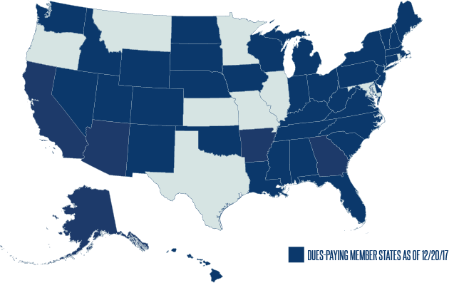
NASPE MEMBER STATES
Notes:
Currently our association has representatives from 40 states.
Speak about the benefits of the diverse group and the ability to share/transfer information from state to state.
Some states, like Texas, have no centralized HR so membership isn’t needed

Slide 5
MEMBER/SPONSORS
Pinnacle NEOGOV
Diamond Cornerstone on Demand | Kronos
Platinum Infor | Merck | Oracle | SAP
Gold Accenture | CPS HR Consulting | UnitedHealthcare & Optum
Silver Kenning Consulting
SPONSORS
Mid-Year Meeting Deloitte | JobAps
Annual Meeting Workday (Platinum)
NASPE CORPORATE MEMBERS
Collaboration
Innovation
Problem-Solving Partners
Corporate Council
Notes:
Share our vendor experience – how they are included in our conferences and provide impactful resources such as white papers, presentations, educational opportunities, etc. \
Next slide is Cavazos video about his experience with membership

Slide 6
NASPE CORPORATE MEMBERS
Collaboration
Innovation
Problem-Solving Partners
Corporate Council

Slide 7
NASPE is a tremendous resource to those proposing and implementing changes that will improve state government. NASPE understands that an open dialogue among its members and the supplier community is the best way to develop cost-effective and reliable solutions.
-Paul J. Campbell, Director, UnitedHealthcare

Slide 8
YOUR STATE NAME
STATE WORKFORCE DEMOGRAPHICS
Add relevant information for your specific audience
Resources –
NASPE Architectural Survey
NASPE Whitepapers
NASPE Executive Committee
NASPE Workforce Issues Committee
Notes:
Target to your audience

Slide 9
NASPE VALUE
ACCESS
To state government HR professionals in your State.
ACCESS
To our corporate sponsors.
ACCESS
To award-winning State HR programs and practices.
Notes:
Now that the audience has an understanding of NASPE – tell them how we can assist their state in the event they are seeking innovative workforce solutions.
Provide contact information to HR Directors and Professionals in their home state.
Provide contact information to vendors
Speak about sharing our best practices – mention the NASPEs.

Slide 10
NASPE VALUE PROPOSITION
The success of an organization is dependent on the ability of its workforce to accomplish its goals. The Human Resources function continually focuses on this workforce. HR adds value to an organization by understanding the mission and vision of the organization and the impact that external forces place upon it. HR practitioners forge strategic partnerships within and outside the organization. The HR department has a quiver of talent and skillsets that work to create an effective and engaged workforce by supporting culture, promoting learning, and ensuring legal and ethical compliance.
Notes:
Drive home what success looks like for a state government.
Sell the HR value proposition.

Slide 11
SUPPORTING THE VALUE OF HR
In order for state governments to fully implement strategies to address workforce issues, executive leaders of the State must view the workforce as a strategic priority.
In state government settings this begins with the sponsorship of the governing body, which include the Governor, Legislature, Civil Service Commissions and Boards.
“More than 7,000 South Dakotans are public servants under my direction in the Executive Branch, and I am surrounded by some of the hardest working and most dedicated employees to be found in any organization.”
-Gov. Dennis Daugaard, SD
Notes:
Get the buy in – especially if the audience happens to be members of “governing bodies”
http://rapidcityjournal.com/news/opinion/columnists/local/daugaard-state-employees-earn-their-recognition/article_b3ac8ce4-fac3-5557-8347-a0c3c1a6358a.html?utm_medium=social&utm_source=twitter&utm_campaign=user-share

Slide 12
TOP WORKFORCE ISSUES
Talent
Culture
Strategic Alignment
Technology
Notes:
State Workforce Issues Committee Concept and how we identified the top issues
The committee began the work to define the most pressing issues facing today’s workplaces by researching current published articles and studies on the topic and drawing from the members’ individual experience in their roles as state HR executives. The committee members held informal discussions with their peers and other executives in state government roles and asked them the following questions:
What is your biggest workforce challenge?
What are your potential roadblocks?
Have you tried anything at your agency or in your division that HR has assisted you with that worked and that you would be willing to share?
What does a successful relationship with HR look like?
Notes from the research and these discussions were compiled and common themes were identified. Those themes are: Talent, Culture, Strategic Alignment, and Technology.

Slide 13
TALENT
Attracting, inspiring and retaining
human capital
that is
productive and engaged.

Slide 14
TALENT
How to create top talent strategies:
2
4
Conduct an analysis of the human capital needed to accomplish mission and vision
Develop and implement plans for current and future talent needs
A clear and relevant organizational mission and vision
Identify
talent gaps
3
1
Notes:
One thing that is constant is CHANGE. Talent Pools, Workforce Trends, and Government.
The key to government is continuity of services; however, at least every four years a state has the potential to shift visions (Elections and Administrations)
Workforce:
Millennials and Generation Z
According to the International Public Management Association, Generation Z, those born after 1995 is set to become one quarter of the US population by 2020 and there are already signs that their desires and expectations regarding work differ from their millennial predecessors.
Millennials are poised to become 75 percent of the workforce by 2025.
What will work look like – Augmented Reality. We are already seeing the use of drones and automation. Think of the transportation department with self driving trucks.
All these issues need to be considered but one thing we know for certain is how to prepare for a talent solution…. Steps 1-4

Slide 15
TALENT SOLUTIONS
ROI
Demonstrate talent’s return on investment
Merit Systems
Promote the positive sides of merit systems and don’t be afraid to push for reforms
Recruitment
Recruit beyond the typical applicant pool
Applicant Experience
Achieve a unified job applicant experience
Notes:
What are some things you think of when the discussion turns to talent in a governmental setting? (i.e.: state employees)
(Audience Responses) use feedback to create collaborative communication.
As with any organization, there are always roadblocks in recruiting, developing and retaining talent. These roadblocks may be perceived or in some cases actually factual. HR professionals align themselves with other executive leaders to create solutions to break down these roadblocks.
Of course in government the old age perception of “antiquated merit systems” is often used to as an excuse for poor performance or inefficiencies. When in fact, we should be promoting the value of merit systems:
Uniform classification and pay systems that create cost controls for taxpayer dollars.
Equal Pay for Equal Work
Opportunity for Advancement
Merit systems can provide a solid guiding philosophy on how to create fairness; but DON’T be afraid to push for reforms. Many states have changed their Civil Service laws to meet modern workforce demands. The most recent has been Tennessee (Get Information)
R.O.I. – Example – Turnover dollars vs. investing in salary increases – loss of productivity and skills
Recruit beyond – (previous applicant pools, disabilities, veterans initiatives, internships, etc.)
Unified Experience – talk about automation and branding – communication between applicant and employer

Slide 16
TALENT SOLUTIONS
Pay
Develop flexible pay mechanisms and provide managers tools to apply with consistency
Mutual Value
Establish a mutual value between employee and employer
Career
Emphasize state service as a career and link employees to the overall mission
Continuous Learning
Build a philosophy of continuous learning
Notes:
Mutual Value – learn what your employees want and need.
Emphasis on career - use goals to link job performance to the mission – and talk about successful outcomes.
Continuous Learning – Training, Leadership Academies, etc.

Slide 17
TALENT SOLUTIONS
Maine (Developing Maine state governments workforce of the future)
Louisiana (Realistic job preview videos)
Tennessee (Civil service reform)
Virginia (Virginia values veterans V3)
Pennsylvania (Commonwealth Mentoring Program)
Pennsylvania (Workforce and Succession Planning Strategic Initiative)
Notes:
Web links to NASPE Award submission & program details. These are examples of state solutions.
BRIEFS:
Maine: Foresight consultants conducted interviews and research, did a literature search, and employed other foresight methodologies to answer 17 questions about the likely future of Maine's work and workforce and how a workforce development plan could lead state workers to a desired future rather than one that just "happens." The substance of this final report was presented to the HR community and later to key executive leaders, people in a position to make decisions, re-direct resources, and submit legislation. The report provided scores of examples of what will likely be the work and workforce of the future, including contextual information for the state (e.g. diminished availability of natural resources and a more ethnically diverse citizenry).
Louisiana's videos target troubled, high-turnover jobs. Each video sheds light on the duties and working conditions of the position and profiles an employee who has been highly
successful in filling that position. These videos introduce prospective employees and/or applicants to the actual work they will be performing in a position through a format that includes employee interviews and work site tours in a very short, 3 to 4 minute video presentation.
Tennessee initiated a new hiring system that stopped depending on ineffective tests and turned instead to a requirement that agencies clarify the knowledge, skills and competencies each position requires. Hand in hand with that came an overhaul of the state’s performance evaluation system. Today, Tennessee has established performance outcomes for each job that are specific, measurable, achievable, relevant and time-sensitive. Even better, in case of layoffs, job performance overtook seniority in decisions about who would keep a job and who wouldn’t. The new law enabled the HR department to promise agencies that they would get applicants with the appropriate qualifications.
Virginia: The Virginia Values Veterans (V3) Program not only aims to educate and train companies as to why it is a sound business decision to recruit, hire, train, and retain Veterans, but also to help those committed companies meet their hiring goals. V3 Member companies will join a highly respected field of private and public sector organizations that have committed to hiring Veterans. These Member companies will have access to cutting-edge best practices in recruiting, hiring, and retaining Veterans. Any company completing all training requirements will be recognized as an official “V3-Certified Company,” and awarded a certificate from the Governor of Virginia.
Pennsylvania Mentoring: The Commonwealth Mentoring Program takes a fresh and exciting approach to formal mentoring by combining mentoring and coaching, practical application and exercises to strengthen curriculum content, experiential activities, one-on-one meetings with mentees/mentors, web-based and classroom training opportunities, individual development planning and core business process identification and documentation into one comprehensive package. Because the CMP uses internal staff and outside speakers who volunteer their time, the Office of Administration is able to offer the program at no cost to participating agencies, many of which lack the budget and staffing resources to create their own leadership development programs.
Pennsylvania Succession Planning: The program was created to identify and mitigate challenges to the Department’s workforce in light of over a quarter of the agency’s employees becoming eligible to retire within the next four years and, most importantly, to maintain a qualified—ready and able—workforce in the state’s transportation industry. Perpetuating this, executives leaders want to create a culture of workforce, succession, and career development planning among agency managers, supervisors, and employees. This is the first time that PennDOT has had executive leadership initiating a holistic approach with definition in the agency’s strategic plan, human resource policy, and individual performance measures for managers, supervisors, and employees.

Slide 18
CULTURE
Creating shared values, assumptions and beliefs, which governs how people behave in organizations.
Notes:
http://media.haworth.com/asset/55249/How%20to%20Create%20a%20Successful%20Organizational%20Culture.pdf
Quite simply, organizational culture involves how an organization functions and expresses itself. Haworth, a leading office furniture manufacturer provided a brief on workplace culture and tells us that
70% of the American workforce is not engaged. (Find states for state government)
Low morale comes at a high cost – disaffected workers cost millions and even billions of dollars each year in lost productivity.
Don’t take CULTURE for granted – Its powerful and takes work!
Value: What a organization does, its mission, and how it represents itself.
In state government it starts with the top “STATE” and breaks into Department cultures, but they should be aligned for success.
Assumptions: the attitudes, often unconscious, formed through organizational processes and actions that inform what employees think
Artifacts: What a company represents in the form of products (or services) technologies, publications, processes, dress code, location and architecture.

Slide 19
CULTURE
The following define your organization’s culture:
Notes:
Value: What a organization does, its mission, and how it represents itself.
In state government it starts with the top “STATE” and breaks into Department cultures, but they should be aligned for success.
Assumptions: the attitudes, often unconscious, formed through organizational processes and actions that inform what employees think
Artifacts: What a company represents in the form of products (or services) technologies, publications, processes, dress code, location and architecture.

Slide 20
CULTURE SOLUTIONS
The state’s executive leaders and managers must create a visual picture of what the organization wants to achieve and define the values that need to be portrayed.
Culture in state government (in most cases) is defined by the Governor.
Human Resources will build policies to support the culture and ensure that such culture is aligned and reinforced with workforce practices.
Notes:
Do you think state governments can create positive culture?
Why or Why not?

Slide 21
CULTURE SOLUTIONS
Train
Ensure middle managers and first-line supervisors are trained on the organization’s culture
Communicate
Visualize
Create a visual picture of what needs to be achieved and define the values that need to be portrayed
Engage
Promote employee engagement; Support mentoring and job shadowing
Notes:
Leaders create the culture – paint the picture.
For some employees the political environment in our nation has created a culture of survival (low morale and perception of government)
Trust in government is near an all time low according to gallup polls.
Creating a positive culture that is adaptive to change is needed to evolve essential governmental services (Get away from we always did it this way)

Slide 22
CULTURE SOLUTIONS
Safety
Adopt clear emergency management and safety programs
Promote
Foster citizen engagement through promoting state employment
Partner
Acknowledge the role of legislators as a stakeholder and build strong relationships
Feedback
Utilize the
G.R.O.W. model (Goal/Reality/ Options/Way Forward)
to facilitate employee feedback

Slide 23
CULTURE SOLUTIONS
Best practices from member States:
Delaware (LinkedIn Showcase)
Kentucky (Workplace Resolutions)
Utah (Abusive Conduct Prevention)
Louisiana (Success Series Webinars)
Oregon (Certified HR Professional Credentialing Program)
Kentucky (Office of Diversity and Equality Training)
North Carolina (Service Awards Programs)
Notes:
Delaware: The state’s Showcase page provide a platform to spotlight a specific business unit, advertise job openings, and provide a glimpse of our culture. In addition, it also helps our search engine optimization as Google frequently ranks LinkedIn high in search results so it helps to push our ranking as high as possible.
Kentucky: Workplace Resolutions is a service for a group of state employees who are in conflict. During the resolution process, a team of mediators meets with each member of a conflicted group individually to listen to their concerns and develop recommendations for the group.
Utah: The Abusive Conduct Prevention program is designed to enhance the professionalism in the workplace for State of Utah government agencies. Specifically, the program seeks to prohibit conduct intended to intimidate, humiliate or cause unwarranted distress along with conduct which exploits a known disability. Simultaneously, the program encourages increased ethical conduct and leadership with integrity through professional development training.
Louisiana: The Success Series Webinars of Louisiana's CPTP (Comprehensive Public Training Program) are regular monthly programs offered on third Thursdays of each month. The interactive workshops are designed to highlight topics that have been identified as vital to the professional and personal success of employees through competency studies, surveys, and evaluations. The programs run an average of 45 minutes and feature specialists from throughout the state, along with polls, quizzes, chats, and best-practices sharing.
Oregon: The State Certified HR Professional (SCHRP) credentialing program is designed to allow HR professionals in Oregon state government to be recognized for mastering state specific human resource areas.
Human Resource Management
The Role of HR in the Public Sector
Legal Considerations in Human Resources
Self‐Awareness and Relationship Management
Human Resources as a Strategic Business Partner
Kentucky: A key component to achieving the goal of inclusive work environments is the ODE training program. This training program is needs-driven and consists of three components: regular monthly training events in harassment prevention, diversity and inclusion, and generational differences; on-site local training for agencies within the enterprise; and specialized training on emerging issues for HR leaders and management professionals at the annual Governor’s Equal Employment Opportunity Conference.
North Carolina: Excellence in Service, North Carolina’s employee service awards program, celebrates length-of-service milestones of employee service to state government. The program is a partnership between the Office of State Human Resources; Correction Enterprises in the Department of Public Safety; and the Museum of History in the Department of Cultural Resources. The Excellence in Service awards program:
Offers products made primarily in North Carolina or, at a minimum, made in the USA;
Celebrates North Carolina’s heritage, culture, symbols and craftsmen;
Offers unique products that, for the most part, cannot be purchased; and
Creates efficiencies by operating the program within state government.

Slide 24
STRATEGIC ALIGNMENT
Process and the results of linking an organization’s structure and resources with its strategy and business environment.
Notes:
When an HR function is strategically aligned, its focus is on providing the human capital the organization needs to fulfill its mission. It requires the organization to have a mission and vision and that the HR function be aligned with them.
.

Slide 25
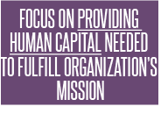
STRATEGIC ALIGNMENT
The keys to strategic alignment
Notes:
The reality of working within the governmental arena is that mission and vision are frequently defined solely in political and not operational terms. Agency structures, policies, and procedures are set by law or rule and do not support strategic operational priorities

Slide 26
STRATEGIC ALIGNMENT
States should implement processes to facilitate communication among stakeholders that supports rapidly identifying and resolving differences between business processes. Human Resources can help ensure alignment between the governing bodies, agencies and the workforce.

Slide 27
STRATEGIC ALIGNMENT SOLUTIONS
Demonstrate and communicate your mission, vision and goals
Make decisions that are in agreement with strategic objectives
Understand the fundamental needs of each stakeholder and ensure alignment between process and goals
Celebrate achievements
Review leadership programs from other States
Notes:
Again, back to mission, vision and goals – need to communicate them!
In a government setting, we often have competing needs of stakeholders, so how to we satisfy them: When a decision has to be made, look to the overarching vision of the Governor, or Agency head – this helps you make a decision.
Celebrate your achievements and use every opportunity to promote your initiatives specifically with citizens and lawmakers.

Slide 28
STRATEGIC ALIGNMENT SOLUTIONS
Best practices from member States:
Utah (DHRM Center for Excellence)
Utah (DHRM Operations Council)
Tennessee (HR Masters Series)
Notes:
Utah: The State of Utah’s Department of Human Resource Management (DHRM) reorganized much of its enterprise level positions into a Center For Excellence (CFE) which has resulted in strong push for the development of progressive HR practice. The CFE reconciled the development of many functions that were vertically managed (recruitment, learning development, employee relations, compensation, classification, data analytics, etc) into one cross functional team lead by our Chief Strategy Officer (CSO). This has empowered DHRM to single task on the highest developmental priorities with a constant stream of cross-functional expertise.
Utah: This council meets monthly and reviews all matters related to HR services becoming better, faster, cheaper, and monitors the implementation of operational treatments. This collaborative forum is where proposals to change HR work is evaluated, matured, and sequenced. It is also a forum of training to aid existing employees in growing into the desired future state of HR.
Tennessee: The goal of the HR Master Series is to enhance HR leadership across state government by moving HR from the transactional model to the current best practice, which is to have HR help drive strategy within an agency.

Slide 29
TECHNOLOGY
The goal of technological resources is to allow decision-makers access to relevant data and to enable organizations to process inputs and outputs more effectively and efficiently.
Better information, Better decisions, Better government!
Notes:
Technology Roadblocks
Antiquated systems
Rapidly changing systems
Budget
Lack of reliable data
Concerns over privacy

Slide 30
TECHNOLOGY
DATA INTEGRITY
Providing accurate, complete and relevant data on the workforce
DATA ANALYSIS
Analyzing data to provide workforce solutions
LEVERAGE TECHNOLOGY
Leveraging technology to increase automation

Slide 31
TECHNOLOGY SOLUTIONS
MAX IT OUT
Push your systems to the limit
SHOW IT
Demonstrate the value added from data decisions
SAFETY FIRST
Security protocols are essential
LOOK WITHIN
Seek technological skills from within the organization
MAKE RULES
Ensure policies and practices are in place for reliable data entry

Slide 32
TECHNOLOGY SOLUTIONS
Best practices from member States:
State of Delaware (Learning Center Implementation)
State of Louisiana (Louisiana Positions Descriptions System)
State of Utah (Targeted Funding)
State of Washington (HR Predictive Analytics Tool)
State of New Jersey (ePar)
Notes:
Delaware: This team of Training Administrators and IT staff identified a need for a statewide learning management system, gained leadership support and funding, and then worked through several challenges and overcame barriers to move the State of Delaware from 45 separate and distinct ways of tracking training, ranging from paper files to outdated legacy systems, to a single centralized system that provides training resources to employees from any computer or device at any time.
Louisiana: In 2015, State Civil Service resumed responsibility for allocating all classified positions, a task that had been delegated to state Agencies. Recentralization of this process was an effort to ensure greater consistency in the allocation of positions as well as provide efficiencies throughout the state. To address this, the Department State Civil Service launched the electronic Position Description System (PDS), allowing Agencies to upload position descriptions electronically to the Compensation Division.
Utah: Provides data-driven, justifiable compensation recommendations that addressed the areas most in need of compensation increases.
Washington: The predictive analytics tool is a regression model and corresponding user‐friendly excel document ("tool") that allows State HR to run relationship analysis on variables that may impact employee turnover.
New Jersey: The e-PAR system is a key initiative to provide innovative, efficient and responsive service delivery to state government by replacing traditional, paper-based performance appraisal methods with an automated process. e-PAR simplifies and automates the employee appraisal process, eliminating the need for paper-based forms and the associated time-consuming tasks of tracking, copying and circulating appraisal forms. It encourages staff involvement and motivation, and increased participation in the planning and delivery of work.

Slide 33
CONTACT US
859-244-8182
http://www.naspe.net
LINKEDIN
TWITTER
1776 Avenue of the States
Lexington, KY 40511
lscott@csg.org
amaddox@csg.org

Slide 34
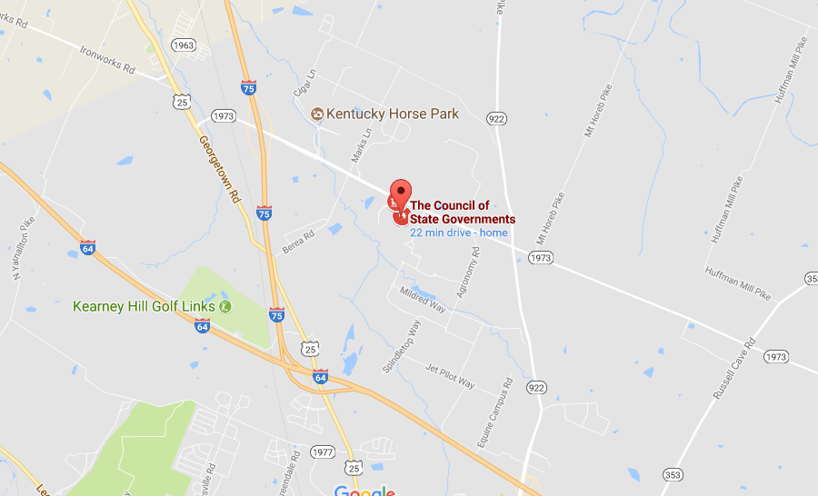
NASPE is an affiliate organization of The Council of State Governments.
Location
NASPE is centrally located in Lexington, KY – a 6-hour drive from such major cities as St. Louis, Atlanta, Chicago and Memphis.

Slide 35
THANK YOU

