Slide 1
Recalculating!
Skills for when life’s GPS
Takes an Unexpected turn
Annual Meeting of the National Association of State Personnel Executives Brenda Clark Hamilton, Ma Ed. July 16, 2018: 9 – 10:15 a.m.

Slide 2
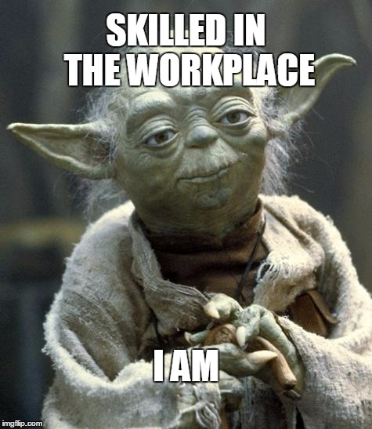
Bragging Time!
Tell one thing that you do well in your work…

Slide 3
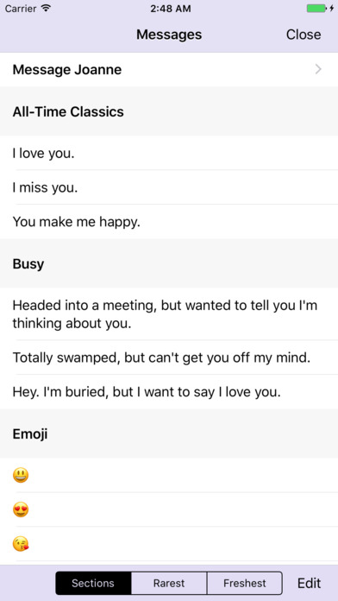
Helpful Information…
Introducing…
The Romantimatic
App!

Slide 4
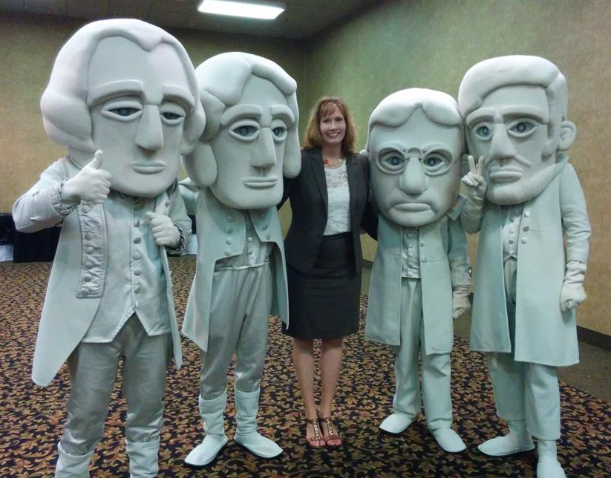

I am truly honored to be here.
“The National Association of State Personnel Executives was established in 1977 to enhance communication and exchange of information among state government personnel executives across the country. NASPE provides a collaborative forum for state HR leaders to share effective leading practices… focused on developing an effective state workforce. NASPE provides educational resources for its members and a forum to share best practices…through meetings, publications, surveys, and online discussion forums.”

Slide 5

RECALCULATING!
SKILLS FOR WHEN LIFE’S GPS TAKES AN UNEXPECTED TURN

Slide 6

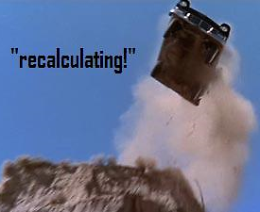

We’ve all been there…

Slide 7
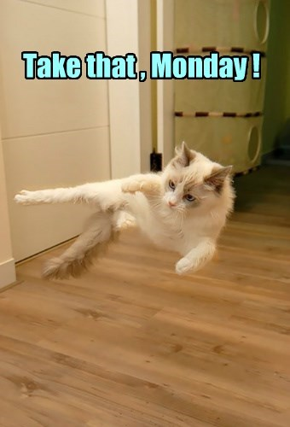
Four Strategies for Navigating
Your Work and Life…
…including any unexpected turns, with wisdom, resilience, creativity, and a can-do attitude

Slide 8

1. CREATE A STRONG MINDSET.
What is your mindset
most days?
Bring it on,
Baby!

Slide 9
The Bank Robber Hypothetical*…
You walk into a bank. There are 50 other people in the bank. A robber walks in and fires his weapon once. You are shot in the right arm. You were the only person hit by the bullet.
The Big Question: Were you lucky or unlucky?
*From The Happiness Advantage, Shawn Achor, 2010

Slide 10
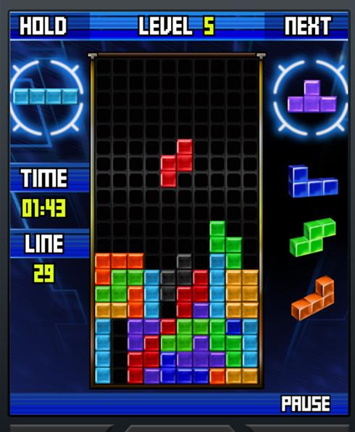
Your mindset absolutely affects how you handle life’s challenges.
The Tetris Effect:
Our minds get stuck in a pattern of viewing things a certain way
(SHAWN ACHOR, HARVARD UNIVERSITY, 2010)

Slide 11
“Cognitive Afterimage”: Our brains “very easily get stuck in patterns of viewing the world, some more beneficial than others” (Achor, 2010)
If you start noticing all of the negatives...
This world view absolutely affects your energy level, success, creativity, happiness, and even your health!

Slide 12

“A person’s level of optimism in the first year of law school predicted his income a decade later. An increase of one tiny point on the optimism scale was worth an extra $33,000 a year…Optimists live longer, are healthier and happier, make better financial plans, and are more successful.”
--Tali Sharot, The Optimism Bias: the Irrationally Positive Brain, 2011

Slide 13
Most of time, do you see yourself as blessed and fortunate…or always getting the shaft?
___I often think of how others have it better than I do.
___I often think of how unlucky I am.
___My boss clearly has favorites, and I am not one of them. He/she would not be happy even if I was the perfect employee!
___I often think of how poorly my day is going.
___I often think of how annoying people are.

Slide 14
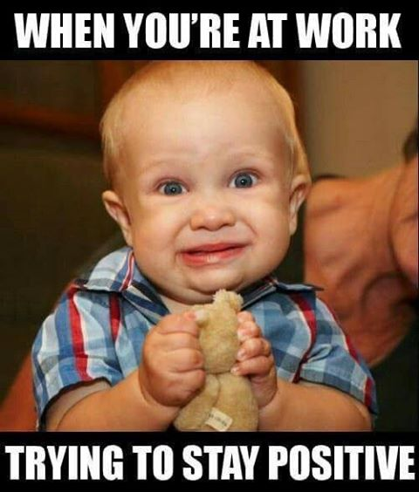
Purposefully focus on successes and the positive aspects of your colleagues, work, and life
Be your own Spam Blocker (Achor, 2010)

Slide 15


Wake up and say ARG!
Anticipate
Recollect
Gratitude
(Eric Barker, 2017)

Slide 16
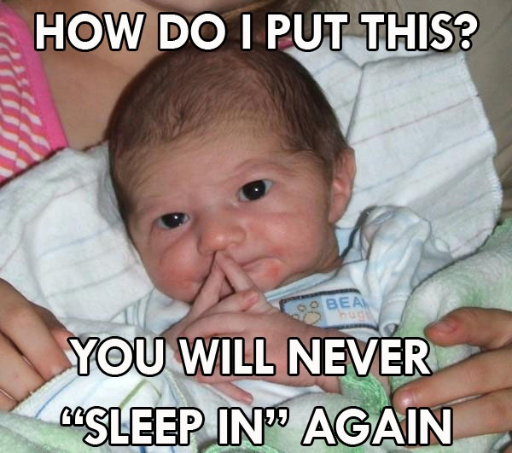
2. Handle change with finesse.
“Raise your hand if...”
Change is a constant in both our personal and professional lives.
“We cannot become what we need to be by remaining what we are.” -Oprah Winfrey

Slide 17
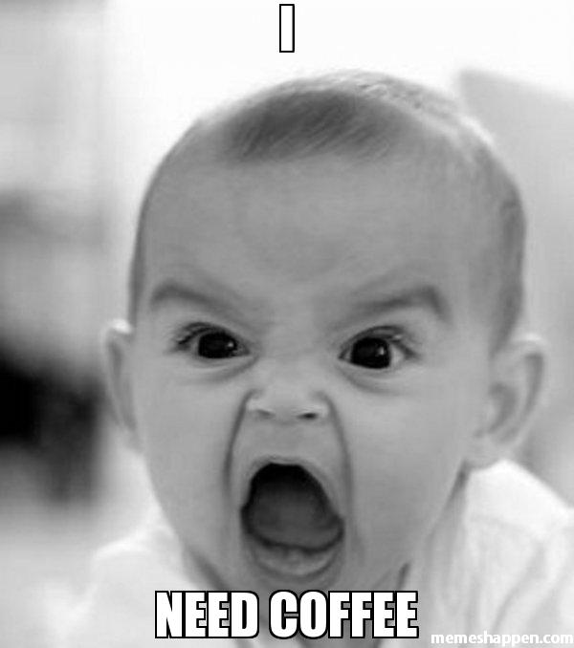
Discomfort during periods of change is to be expected:
  Letting Go
  Neutral Zone
  New Beginning
  (William Bridges, Ph.D., Managing the Transitions)

Slide 18
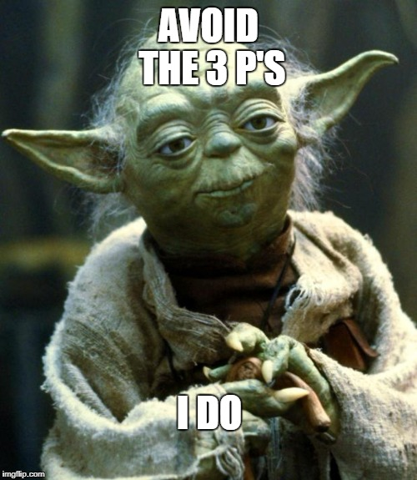
Avoid the Three P’s: (Dr. Martin Seligman):
  Permanence
  Pervasiveness
  Personalization

Slide 19
Be aware of Selective Memory

Slide 20
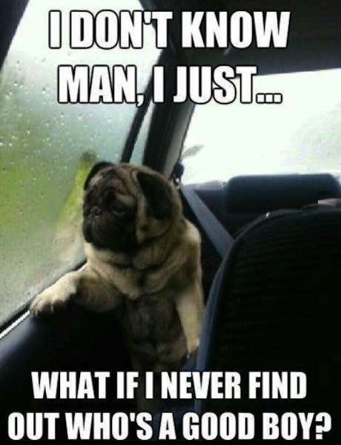
3. CREATE YOUR OWN IDENTITY.
Four Key Identities:
Remembered
Reflected
Programmed
Created
(Goldsmith, Mojo, 2009)

Slide 21

Ask, “Who do I want to be?”
List what is your Created Identity, and review it often!

Slide 22

Always Know Who Is And Isn’t
on Your Personal Board of Directors

Slide 23
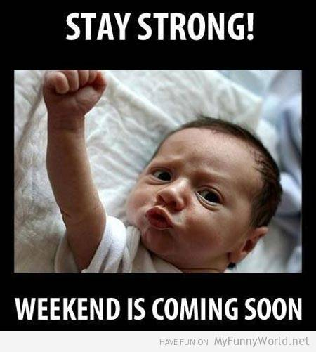
4. live and work with Mojo!
The Life Can Be Annoying quiz!
“Sounds like life to me.”
Reality: People are drawn to being around happy people. (DIENER & BISWAS-DIENER, HAPPINESS: UNLOCKING THE MYSTERIES OF PSYCHOLOGICAL WEALTH, 2008)

Slide 24
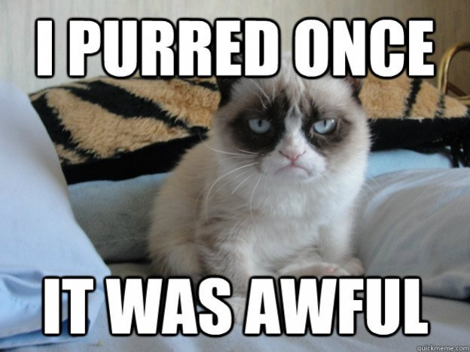
Mojo vs. Nojo
(MARSHALL GOLDSMITH, MOJO: HOW TO GET IT, HOW TO KEEP IT, HOW TO GET IT BACK IF YOU LOSE IT, 2009)
Take responsibility
Move forward
Run the extra mile
Love doing it
Appreciate opportunities
Make the best of it
Inspirational
Grateful
Curious
Caring
Zest for life
Awake
Play the victim
March in place
Satisfied with the minimum
Feel obligated to do it
Tolerate requirements
Endure it
Painful to be around
Resentful
Uninterested
Indifferent
Zombie-like
Asleep

Slide 25
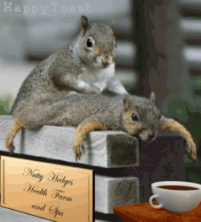
Recognize when you are getting grumpy and ask, “What do I need?”

Slide 26

Take Tony’s advice!
Stability
Novelty
Stretch that comfort zone…
It will elevate your mood, and your comfort zone will grow!

Slide 27
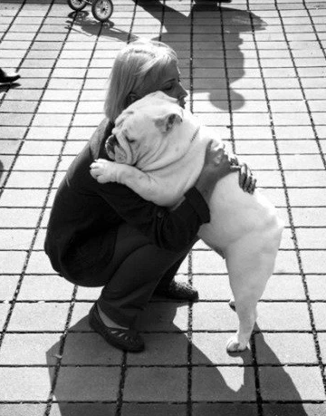
The PSU HUG STUDY! (Chipman, Eastern Psychology Association, Penn State University)

Slide 28

Recalculating!
What is one point that will stick with you from this session?

Slide 29
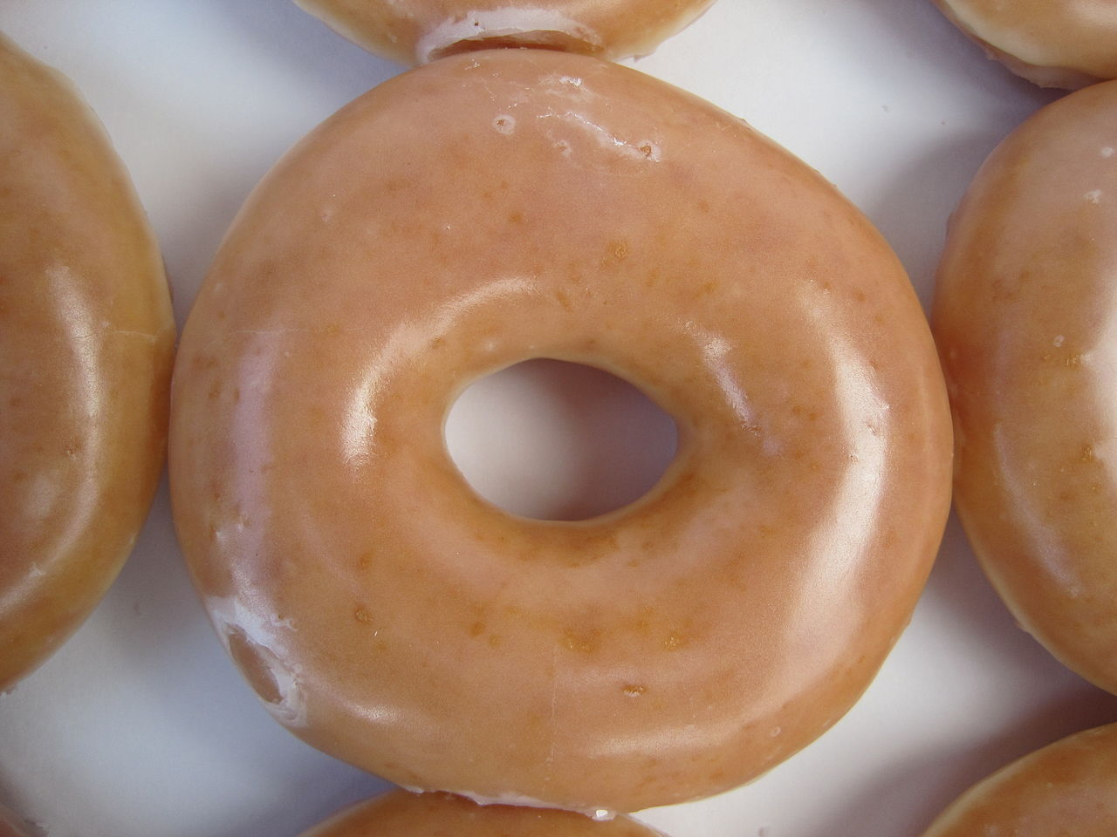
A Closing challenge…
On a daily basis, learn to Enjoy the Glazed Donut!
(Diener & Biswas-Diener, 2008)

Slide 30

LinkedIn: Brenda Clark Hamilton
Facebook: facebook.com/BrendaClarkHamilton

