Slide 1
Governor’s Transitions and Human Resources
July, 2018
Version 1

Slide 2
Contents
Overall State Challenges
Human Resources Trends
Facing Challenges – Making the HR Connections

Slide 3
Overall State Challenges
Top Issues by National Governor’s Association

Slide 4
Overall Challenges
Citizens
OVERALL FOCUS
HUMAN RESOURCES IMPACT
Better Customer Service
Employee Performance Management
Support and Continuation of Programs
Classification and Compensation Programs
Deliver High Quality Service
Aging Workforce
Branding and Perception of State Government
Recruiting and Retaining Top Talent
Employee Engagement Programs

Slide 5
Overall Challenges
Fiscal Constraints
OVERALL FOCUS
HUMAN RESOURCES IMPACT
Reduce Operating Expenses and Waste
Classification and Compensation Programs
Transparency and Accountability to Taxpayers
Healthcare and Benefit Programs
Media Scrutiny
Digitalization – Modern HR Solutions
Improve Efficiency – Do More with Less!

Slide 6
Overall Challenges
Economic Development: Future Growth
OVERALL FOCUS
HUMAN RESOURCES IMPACT
Investments in Public Safety, Education and Health and Human Services
Succession Planning
Attract New Businesses
Aging Workforce
New and Expanded Revenue Opportunities
Recruit and Retain Top Talent

Slide 7
Trends
What is happening in Human Resources?

Slide 8
Trends
Global Trends
Recruiting the best talent for the job
Teaching new skills to Millennials
Flexible work arrangements
Employee Empowerment
AI in Human Resources
Learning available online
Global Leadership

Slide 9
Trends
Public Sector Outlook
Slowly adopting flexible work schedules
Hiring challenges are for Public Safety, Technical, Health care, and skilled trade requiring specialized training or certifications
Increase in retirements over last year
Hiring on the rise
6%
5x
Workforce Under 30
IT Workforce composed of 5 times number of employees are >60 than under 30

Slide 10
Trends
Public Sector Outlook
30% feel that their organizations effectively empower employees to manage their careers
78% of public sector respondents recognize the importance of C-suite collaboration, while only 21% believe their C-suite leaders actually work together on projects or strategic initiatives
15% have a well-defined strategy for the hybrid workforce
20% are working on well-being initiatives
Only 6% use people data analytics as an integral part of business and talent decisions

Slide 11
Trends
States can Lead Controlling Health Care Costs
State employee health plans are often the largest commercial plans in the state and in 18 states, the plans cover over 10% of the commercial market.
“97% of employers are concerned about controlling healthcare costs and 66% are very concerned.” This is a top concern for businesses across your state.
State employee health plans can lead by example leveraging their market power to pay for value and not volume.
“State employee health plans are already implementing a variety of payment reforms…and …there is evidence that these options can encourage enrollees to chose higher value care and improve quality while reducing costs.”
Successfully controlling costs has to include motivating individuals to take an active role.
“Approximately one-half of all adults in the US have 1 or more chronic health conditions and 7 in 10 Americans are over weight or obese.”

Slide 12
Trends
HR Top Priorities
Recruitment and retention of qualified personnel for public service
Employee Morale
Competitive Compensation Package
Customize to Your
State Top 3 Priorities and State Logo

Slide 13
Facing Challenges – Making the HR Connection
Your Human Resources Partner

Slide 14
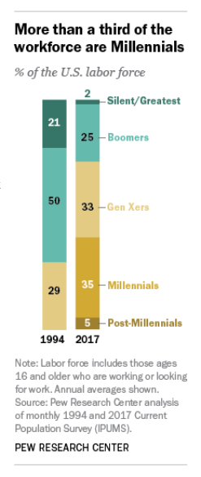
The Current Workforce
Facing Challenges
A full 87% of millennials say professional development or career growth opportunities are very important to them in a job.
Traditionalists (Silent Gen)
Baby Boomers
Gen X
Millennials (Gen Y)
Gen Z

Slide 15
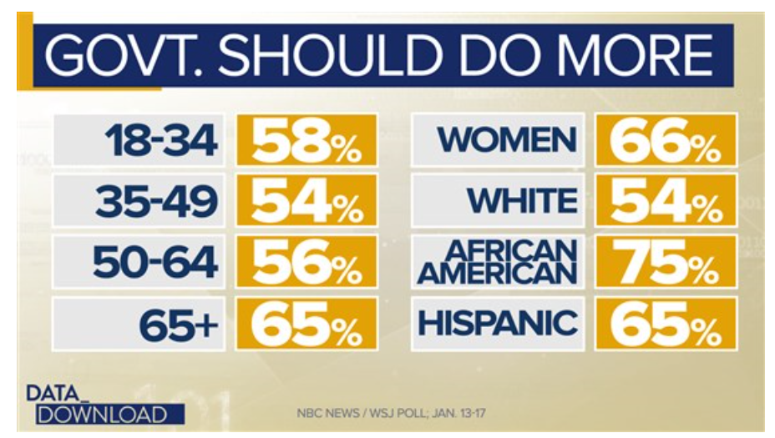
Facing Challenges
Priority: Citizens
Speed, simplicity, and efficiency make citizens happier
Satisfaction is often lower for more essential services
Citizens are less satisfied with government services than with private-sector services
People who don’t use a service are often more skeptical about its quality
Most citizens prefer to interact with government online

Slide 16
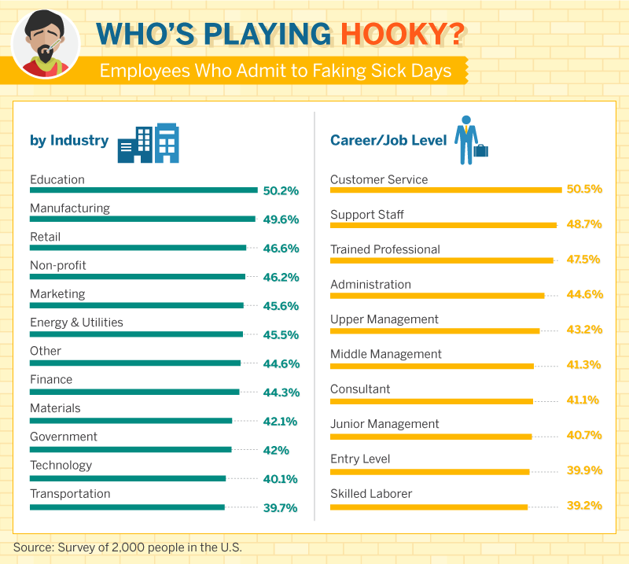
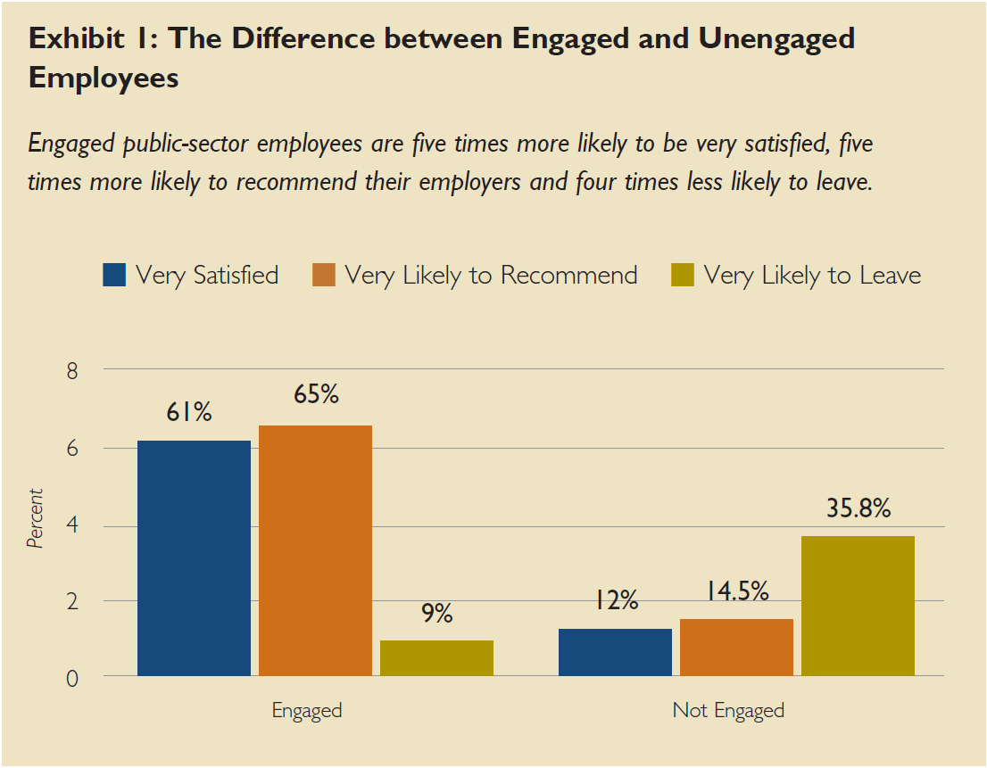
Facing Challenges
How does HR Impact Citizens?
Recruit and Retain Talent
Performance Management
Employee Engagement

Slide 17
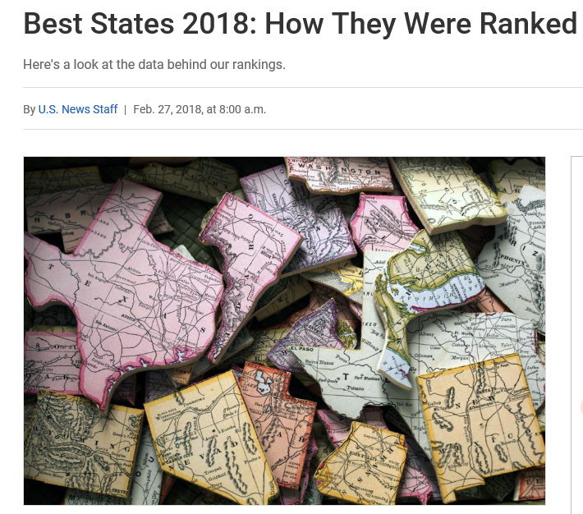
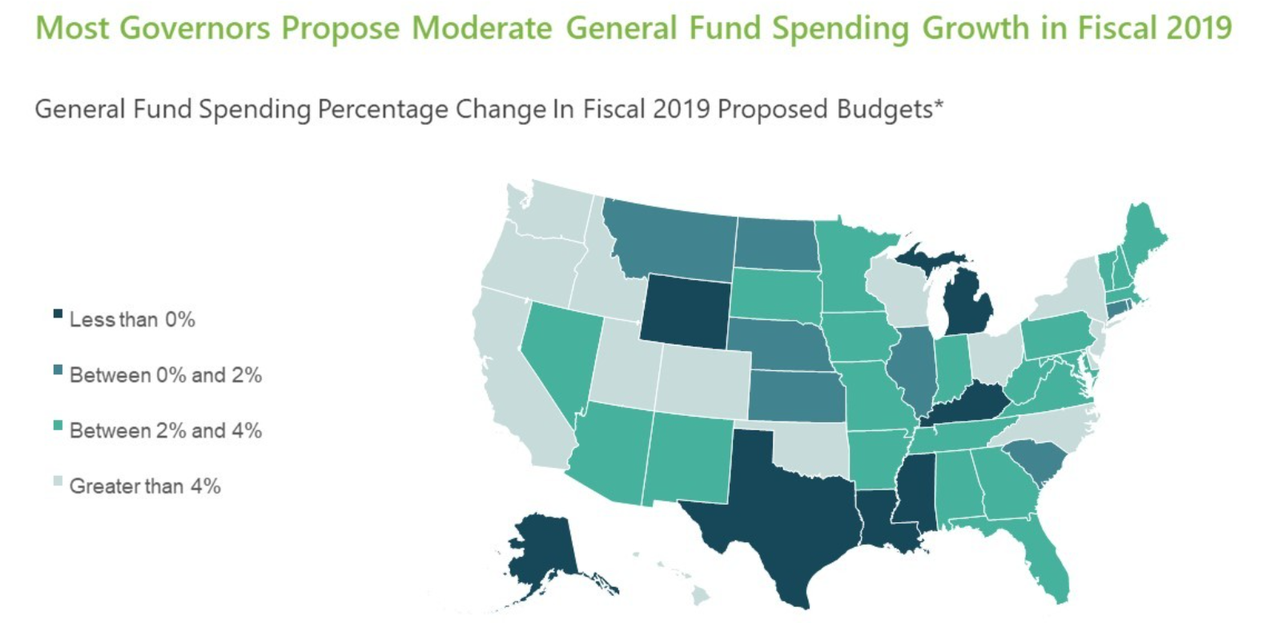
Facing Challenges
Priority: Fiscal Responsibility

Slide 18
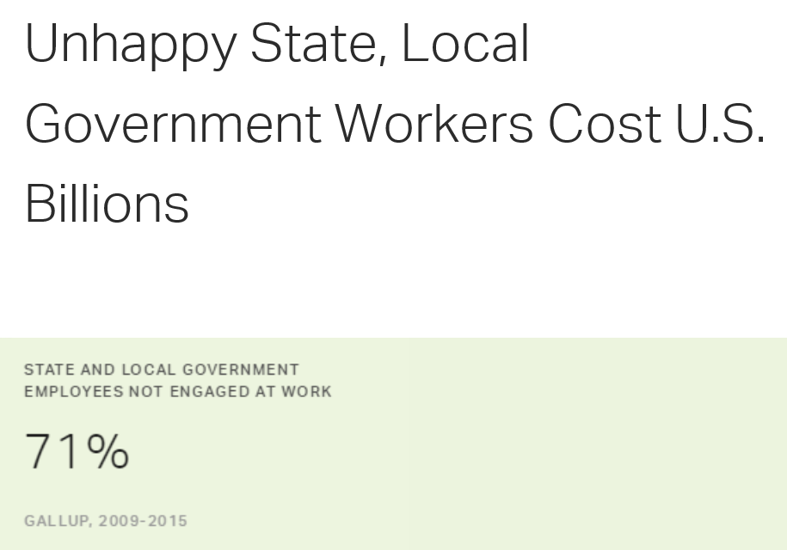
Facing Challenges
How does HR impact Fiscal Responsibility?
Employee Healthcare
Classification and Compensation
Digitalization: Modernization of HR Processes/Systems

Slide 19
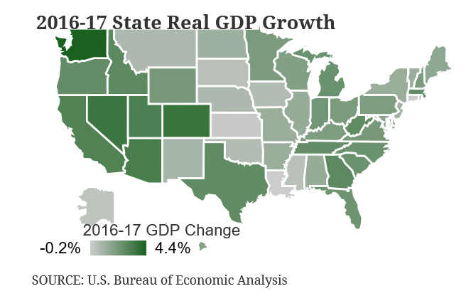
Facing Challenges
Priority: Economic Development and Future Growth

Slide 20
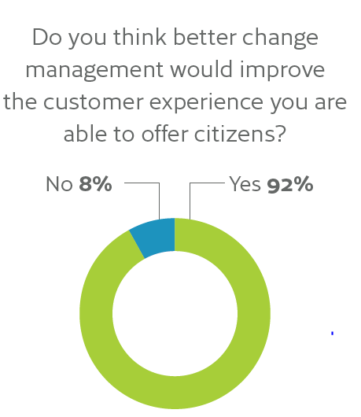
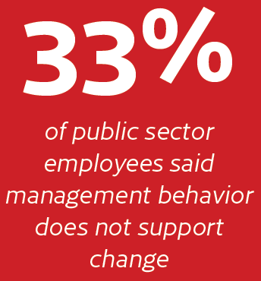
Facing Challenges
How does HR impact Economic Development: Future Growth?
Recruit and Retain Top Talent
Succession Planning/Aging Workforce
Change Management

Slide 21
Appendix

Slide 22
Appendix
Center for State & Local Government Excellence, Survey Findings State and Local Government Workforce: 2018 Data and 10 Year Trends, https://slge.org/wp-content/uploads/2018/05/SLGE2018Workforce.pdf
Deloitte, 2018 Global Human Capital Trends Report
GovLoop, Your Guid to the Top 4 Trends in Government HR, https://issuu.com/govloop/docs/your_guide_to_the_top_4_trends_in_g?e=3570346/62813752
Society for Human Resource Management, Look ahead at HR trends for 2018,
https://www.shrm.org/shrm-india/pages/look-ahead-at-hr-trends-for-2018.aspx

Slide 24
Open Dialogue

Slide 25
Open Dialogue – NASPE State Members
What topics resonate with your State? Which ones don’t?
Are you already having similar conversations?
Would you switch any of the Governor or HR priorities?
What other topics or research would you want to see added?
Could you take the deck and make it your own?
What impact do you think this will have on new Governors?

