Slide 1
Annual Business Meeeting
July 17, 2018

Slide 2
Approval of minutes
January 2018

Slide 3
Treasurer’s report
FY 2018 Year End
FY 2019 Budget

Slide 4
2018 Projected Year end
Budgeted Fund Balance $332,449.18
Projected Year-End Fund Balance: $314,379.20

Slide 5
2018
Dues received from 42 states/budgeted for 42 states
10 corporate members – budgeted for 14.
Anticipated corporate revenue not received
Higher than budgeted expenditures and less than anticipated revenue for 2018 Mid-Year Meeting

Slide 6
2019 Budget
Budgeted Projection: Loss of $14,965.25 – but still maintains 80 percent of previous year’s operating budget.
Assumes 42 state dues and 10 corporate members
Anticipates significant health insurance premium increase for staff, but, hopefully, some relief in retirement contributions for staff in Kentucky Retirement System.
Member travel costs a bit higher than last year due to flight costs into Rapid City
Mid-Year Meeting continues to operate at a loss; proposed registration increase from $325 to $395.

Slide 7
Fund Balance
 | FY18 Budget | FY 18 YTD | FY 18 Year-End Projections | FY19 Proposed Budget
Beginning Fund Balance | 312,405.81 | 306,749.46 | 306,749.46 | 314,379.20
Revenue Over Expenditures
Administration | 6,949.00 | (5,844.17) | (1,483.84) | (15,681.50)
Annual Meeting | 19,465.00 | 21,630.77 | 21,630.77 | 9,825.00
Mid-Year Meeting | 6,370.00 | (14,263.28) | (12,517.19) | (9,108.75)
Total Revenue Over Expenditures | 20,044.00 | 1,523.32 | 7,629.74 | (14,966.25)
Ending Fund Balance | 332,449.81 | 308,272.78 | 314,379.20 | 219,413.95

Slide 8
Administration cost center
 | FY18 Budget | FY18 YTD | FY 18 Year-End Projections | FY 19 Proposed Budget
Revenue | 268,000 | 237,045.05 | 255,722.66 | 258.400.00
Expenditures | 261,051.00 | 242,889.22 | 257,206.50 | 274,081.50
Revenue Over Expenditures | 6949.00 | (5,844.17) | (1,483.84) | (15,681.50)

Slide 9
Annual Meeting Cost CEnter
 | FY18 Budget (Maine) | FY18 YTD (Maine) | FY 18 Year-End Projections (Maine) | FY 19 Proposed Budget (South Dakota)
Revenue | 100,000.00 | 108,548.00 | 108,548.00 | 82,065.00
Expenditures | 80,535.00 | 89,617.23 | 89,617.23 | 72,240.00
Revenue Over Expenditures | 19,465.00 | 21,630.77 | 21,630.77 | 9.825.00

Slide 10
Mid-Year Meeting Cost Center
 | FY18 Budget | FY18 YTD | FY18 Year-End Projections | FY19 Proposed Budget
Revenue | 17,150.00 | 14,800.00 | 16,612.50 | 18,690.00
Expenditures | 23,520.00 | 29,063.28 | 29,129.69 | 27,798.75
Revenue Over Expenditures | (6,370.00 | (14,263.28) | (12,517.19) | (9,108.75)

Slide 11
Dues INCREASE
Policy to increase dues every five years
FY2020 would be next time to increase dues from $5,000 to $5,500

Slide 12
State membership
Received from 32 states to date for FY 2019; More in process
Dues from 42 states were received in FY 2018
36 Gubernatorial Elections in 2018 (17 incumbents retiring or term-limited)

Slide 13
Nominating Committee
2017-18 Executive Committee slate

Slide 14
2017-18 Executive Committee |  | 2018-19 Executive Committee Proposed
President | Joyce Oreskovich, ME | President | Byron Decoteau, LA
President-Elect | Byron Decoteau, LA | President-Elect | Laurie Gill, SD
Secretary/Treasurer | Laurie Gill, SD | Secretary/Treasurer | Franklin Plaistowe, WA
At-Large (3 years) | Franklin Plaistowe, WA | At-Large (3 years) | Matt Fedorchuk, MI
At-Large (3 years) | Kate Sheehan, AK | At-Large (2 years) | Tom Stephens, KY
At-Large (2 years) | Susan Buxton, ID | At-Large (2 years) | Kate Sheehan, AK
At-Large (2 year) | Justin Najaka, NM | At-Large (1 year) | Susan Buxton, ID
At-Large (1 year) | Tom Stephens, KY | At-Large (1 year) | Justin Najaka, NM
Imm. Past President | Rebecca Hunter, TN | Imm. Past President | Rebecca Hunter, TN
Host State or 1-year At-Large | Matt Fedorchuk, MI | Host State | Britni Saunders, IN

Slide 15
Corporate membership Council
Jennifer Dowd, Kronos
Heather Sherlock, Infor
Co-Chairs

Slide 16
2019 meetings
Mid-year and annual

Slide 17
Mid-year Meeting
January 25-27
Washington, DC
Agenda and Registration available in October

Slide 18
2019 Annual Meeting
July 21-24
Marriott (Downtown)
Indianapolis, IN

Slide 19
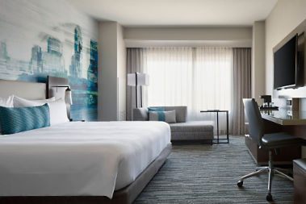
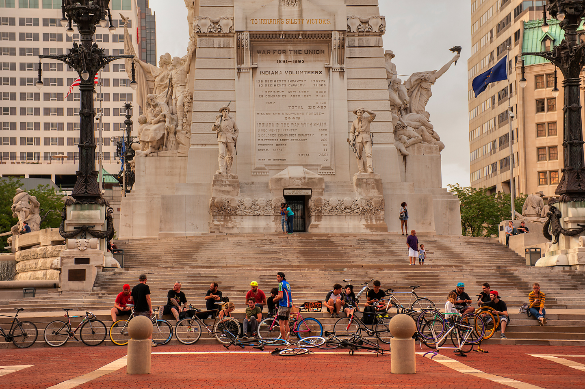
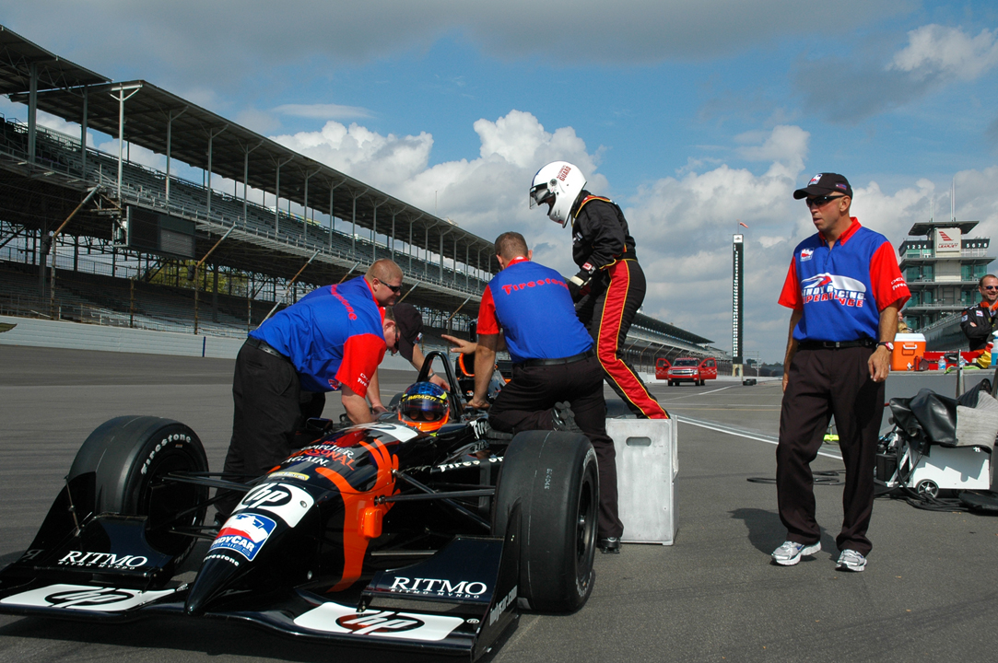
Marriott Downtown
Marriott Downtown
Newly remodeled
Walking distance to NCAA Hall of Fame, State History Museum, Shopping, Monument Circle, State Capitol
Other attractions include:
Indianapolis Motor Speedway
Indianapolis Zoo
Dallara Factory
Indianapolis Speedway Museum

Slide 20
2020 annual meeting
Call for bids

Slide 21
2020 Call for Bids
2020 Annual Meeting (July)
Official “call” will be distributed to members in early August.
Deadline for proposal to NASPE staff – December 7, 2018
Proposals presented to Executive Committee in January in conjunction with Mid-Year Meeting

